Slide 1

Team Four
Sumit Khanna
Nicole Hite

Slide 2

Nicole Hite
Accounting Major
Music Minor
Sophomore
Hobbies:
  Playing percussion, guitar, and clarinet
  Rollerblading
  Raising chickens
  Volleyball

Slide 3

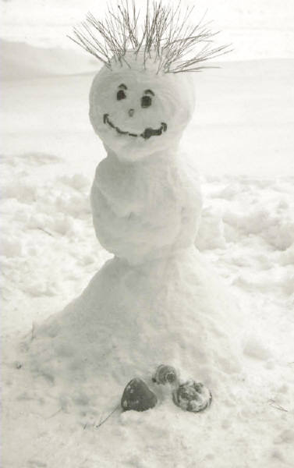
Sumit Khanna
4th year Computer Science Major
Hobbies
  Swing Dancing
  Caving
My ultimate goal in life is to start a revolution
Website: http://journal.sumdog.com

